Slide 1

Spark

Slide 2
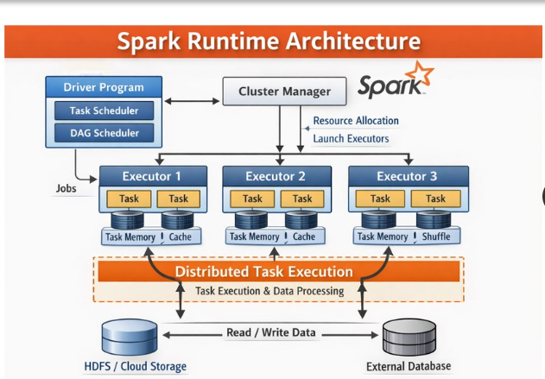

Slide 3
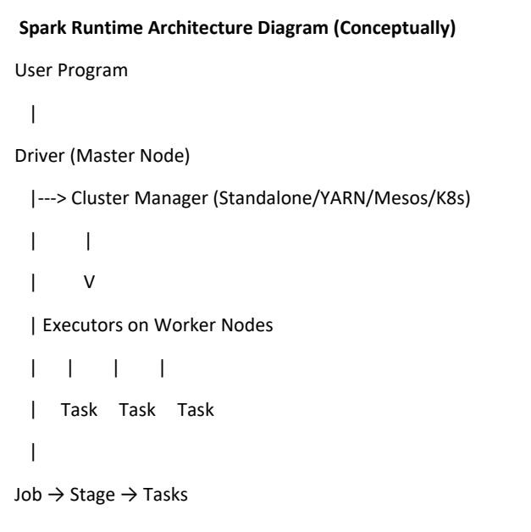
Apache Spark follows a master-slave architecture.
It distributes data and computation across multiple nodes to process large-scale data efficiently.

Slide 4
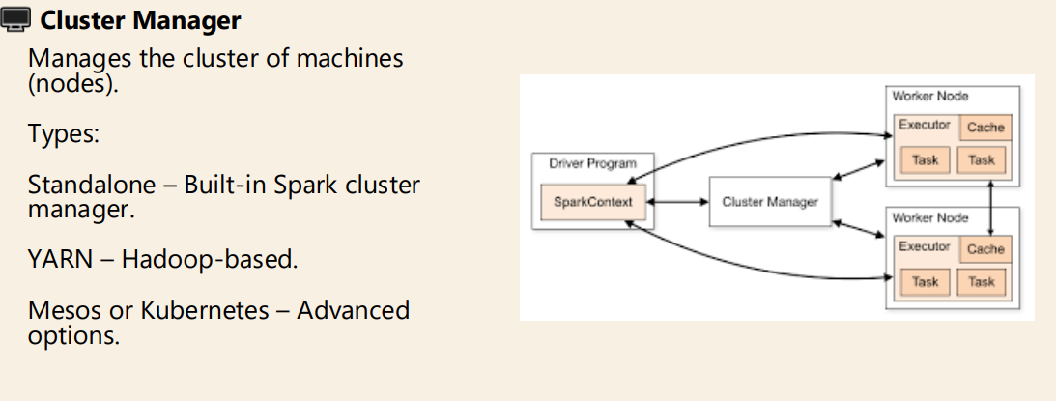

Slide 5
Spark Cluster Manager
Cluster Manager | Used For
Standalone | Spark’s built-in manager
YARN | Hadoop ecosystem
Mesos | General cluster manager
Kubernetes | Container-based deployment
A Cluster Manager is responsible for managing cluster resources (CPU, Memory) and allocating them to Spark applications.
Types of Cluster Managers:

Slide 6

Architecture:
Driver → Cluster Manager → Executors
Cluster manager decides:
How many executors
Memory per executor
CPU cores allocation

Slide 7
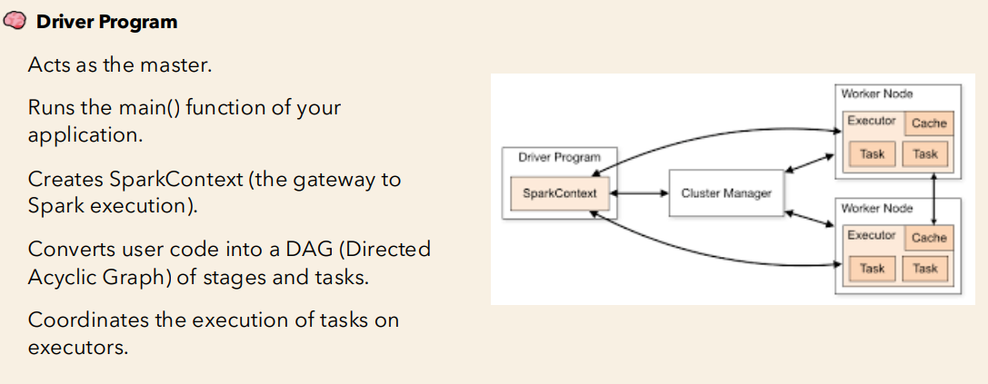
2. Driver

Slide 8
Driver Class Configuration
Important Driver Configurations:
spark.driver.memory
Memory allocated to the driver.
Should be sufficient for collecting results
Increase when using collect(), broadcast variables, or large aggregations
spark.driver.cores
Number of cores allocated to the driver process.
Often set equal to executor cores for balance
Increase for large scheduling workloads
--driver-memory 4G
--driver-cores 2
--conf spark.driver.maxResultSize=1g

Slide 9
Spark submit
What is spark-submit?
spark-submit is the command-line interface used to submit your Spark applications to a cluster (local, YARN, Standalone, Mesos, Kubernetes).
It does
Launch the driver program
Communicate with the cluster manager
Allocate executors
Initiate task execution

Slide 10
Spark-submit Overview
Deploy Modes:
spark-submit is used to submit Spark applications to cluster.
spark-submit \
--master yarn \
--deploy-mode cluster \
--driver-memory 4G \
--executor-memory 4G \
--num-executors 4 \
app.py
Mode | Driver Location
client | Runs on local machine
cluster | Runs inside cluster

Slide 11
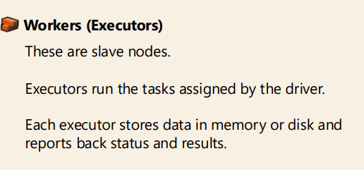

Slide 12
Key Configuration Parameters-Executors
Spark.executor.cores:
Defines the number of CPU cores per executor.
Default: 1
Recommended: 3--5 cores per executor
Spark.executor.memory:
Defines memory allocated per executor.
Executor Memory
├── Execution Memory (shuffle, joins)
└── Storage Memory (cache)
Memory overhead is typically:
max(384MB, 10% of executor memory)

Slide 13
Key Configuration Parameters-Executors
Spark.executor.instances
Defines total number of executors in the cluster.
Number of Executors = Total Available Cores / spark.executor.cores

Slide 14
Configure Memory (Driver + Executor)
1. spark.driver.cores
2. spark.driver.memory
3. spark.executor.cores
4. spark.executor.instances
5. spark.executor.memory
Spark Memory is divided into:
--executor-memory 8G
--conf spark.memory.fraction=0.6
--conf spark.memory.storageFraction=0.5

Slide 15
Executors
Executors:
Run on worker nodes
Execute tasks
Store cached data
--num-executors 5
--executor-cores 4
--executor-memory 8G
Total cores = num-executors × executor-cores

Slide 16

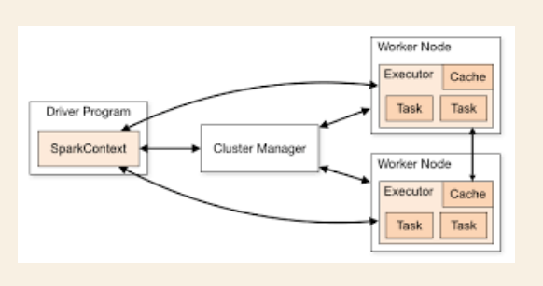
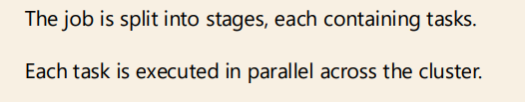

Slide 17
Spark Jobs Troubleshooting
Common Issues:
1. OutOfMemoryError
Too many partitions
Large shuffle
collect() on huge data
2. Skewed Data
One partition much larger
One task takes long time
Solution:
Repartition
Salting
Broadcast join
3. Too Many Small Files
Use coalesce()
Increase partition size

Slide 18
Spark Caching Overview
Used to store data in memory for faster reuse.
df.cache()
df.persist()
Use caching only if reused multiple times.
Storage Levels:
Level | Description
MEMORY_ONLY | Fastest
MEMORY_AND_DISK | Safer
DISK_ONLY | Slower

Slide 19
Use Case – ETL / ETL Data Pipelines
More number of executor instances
Moderate number of cores
Balanced memory allocation based on data shuffling happens

